Slide 1


CAREERPILOT: AI-Powered Career Intelligence
AI-powered resume & JD matching with human-like assistance
Gemini 3 Hackathon
Notes:
Image source: AI-generated

Slide 2

AGENDA
• Job seekers struggle to interpret JDs and tailor resumes
• Case Study: CareerPilot's Technical Evolution and Impact
Notes:
The History and Impact of Automated Resume Matching in Career Technology Case Study: CareerPilot's Technical Evolution and Impact Image source: AI-generated

Slide 3
AUTOMATED RESUME MATCHING IMPACT
From rule-based matching to human-like AI guidance
Notes:
The Evolution of Resume and Job Description Matching Technologies, How AI Transforms Career Guidance: From Rule-Based Systems to Human-Like Assistance

Slide 4
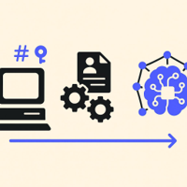

Evolution of Resume Matching
Early Keyword Filters (1990s)
Basic ATS used simple text queries to screen resumes by matching keywords.
NLP and ML Progress
Systems advanced to semantic understanding, interpreting context and intent beyond frequency.
Today’s AI Matching
Accurate parsing of skills, experience, and education accelerates screening and boosts efficiency.
Widespread Adoption
Over 98% of Fortune 500 use ATS platforms that embed these technologies.
Notes:
Automated matching technology began in the 1990s with basic keyword matching algorithms, allowing early applicant tracking systems (ATS) to filter resumes based on simple text queries. Over time, advances in natural language processing (NLP) and machine learning enabled more sophisticated semantic matching, moving beyond keyword frequency toward understanding context and intent. Today, resume matching systems can parse candidates' skills, experience, and education with high accuracy, improving recruiter efficiency and candidate screening speed. Industry adoption has grown rapidly, with reports indicating that over 98% of Fortune 500 companies use some form of ATS, which often incorporates these matching technologies. Image source: AI-generated

Slide 5
The Solution: CareerPilot
AI-powered platform for:
JD analysis
Resume matching
Knowledge graph generation
Personalized guidance
Built with Gemini, vector search, and secure cloud architecture

Slide 6
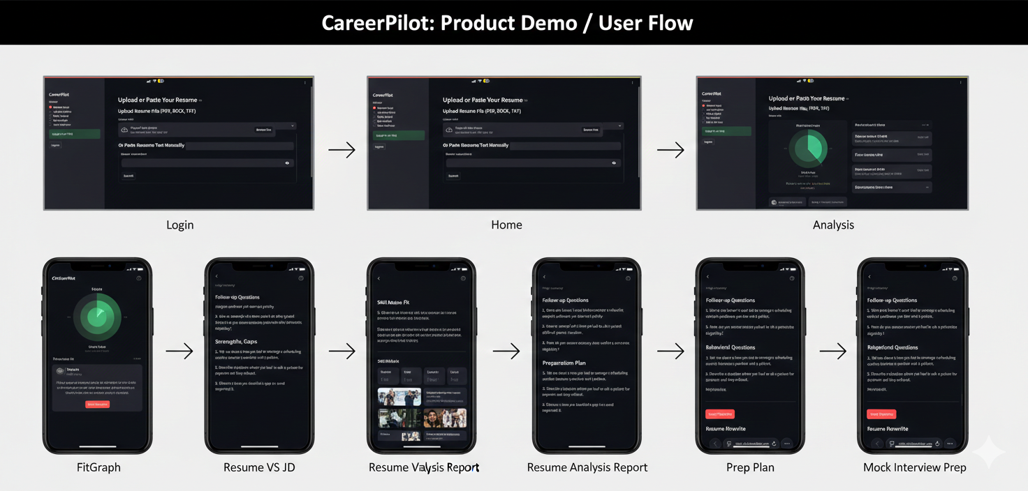

Slide 7
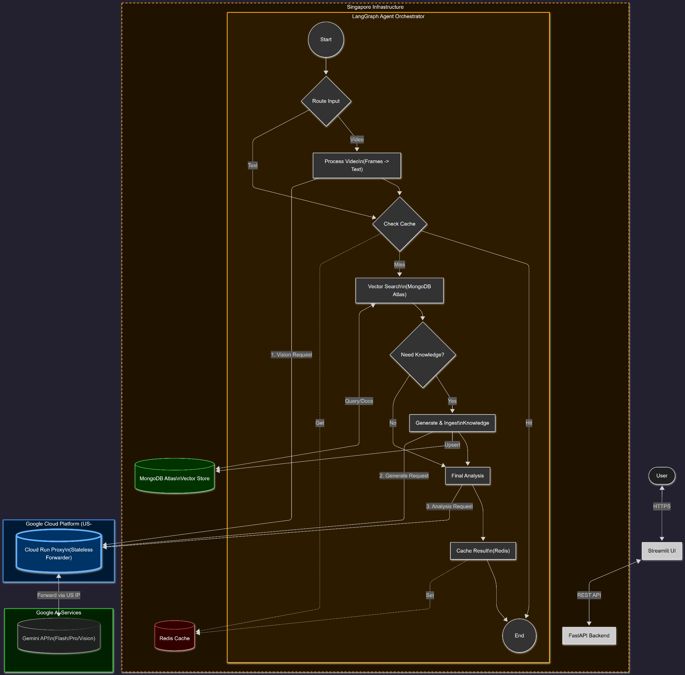
Technical Architecture
Stack:
FastAPI, Python, Kubernetes (k3s), containerd
Gemini (text, vision, embeddings)
Cloud Run proxy
Vector search + agent orchestration

Slide 8
Engineering Challenges & Solutions
A
Gemini Geofencing
Singapore VM blocked by Gemini
RCA: IP reputation, ASN, region
Solution:
Cloud Run proxy in supported region
B
K3s Deployment Pitfalls
Stale images, no registry
Solution:
Local tagging, containerd import, manifest verification
C
Cloud Run Health Failures
Empty-body responses → JSONDecodeError
Solution:
Health endpoint + raw byte forwarding
D
Gemini API Versioning
v1 vs v1beta mismatch
Solution:
Client-side routing, version-aware paths
E
Proxy Design Mistake
Hardcoded version → redeploys
Solution:
Static proxy, smart client

Slide 9
Case Study Impact
Real-world debugging under pressure
Architecture evolved through necessity
Now stable, scalable, and future-proof
Demonstrates deep technical leadership and adaptability

Slide 10
Market Opportunity
Millions of job seekers globally
Growing demand for AI career tools
B2C (job seekers) + B2B (recruiters, platforms) potential
CareerPilot can plug into existing job boards, ATS systems, or resume builders

Slide 11
Business Model
Freemium model for individuals
Subscription for advanced features
API licensing for platforms
Enterprise integrations for recruiters

Slide 12
Competitive Landscape
Resume.io, Rezi, Jobscan, etc.
CareerPilot differentiates via:
Deep JD understanding
Personalized agent responses
Transparent architecture
AI-powered knowledge graphs

Slide 13
Roadmap
MVP built and deployed
Resume analysis agent
Vision model integration
Chrome extension for job boards
Enterprise pilot with recruiters

Slide 14
Team & Background
Niraj Kumar Adhikary
Principal API Architect, 16+ years
Deep expertise in cloud-native systems, security, and AI integration
Proven track record of solving complex infra and API challenges
Allah Nawaz
Software Developer
Zain Ul Abideen
Software Developer
Sadia Cheema
QA

Slide 15
Ask / Investment Opportunity
Seeking strategic partners and funding to:
Scale infrastructure
Expand feature set
Launch B2B integrations
Grow user base
Open to grants, angel investment, or platform partnerships

Slide 16
Thank You / Contact
Niraj Kumar Adhikary (niky.sway@gmail.com )(https://www.linkedin.com/in/nirajadhikary/ ) (https://github.com/nirajmind )
Allah Nawaz(allahnawaz106@gmail.com ) (https://www.linkedin.com/in/allahnawaz01/ ) (https://github.com/allah-nawaz )
Zain Ul Abideen (malikzainulabideen.691@gmail.com ) (https://www.linkedin.com/in/zainwebdev/ ) (https://github.com/ZainDev69 )
Sadia Cheema (saadiyaharif1@gmail.com ) (https://www.linkedin.com/in/sadiaarif/ ) (https://github.com/saadiyaharif )
- Medium blog link - https://medium.com/@nirajmind/when-gemini-blocked-my-singapore-vm-a-real-world-journey-through-k3s-cloud-run-proxies-ai-f95846b93566
Live Link -- https://careerpilot.chickenkiller.com/

